Slide 1
Intro To VLSI Project
Design of a vending machine
By
Praneeth Vasantham(200330020)
&
Gangula Jashwanth Reddy(201030068)

Slide 2
Problem Description
Cost of product – Rs 6.
Possible inputs – Re 1, Rs 2, Rs 5, Rs 10
Possibility To cancel(considered as input)

Slide 3
Assumptions
We are not limiting the amount of change in the vending machine.
If Rs 10 coin is available it can only be give as input at the start.
We also have not given any limit to the amount of the product.
When the input amount crosses Rs6 the product and the change are given (no stacking of product)

Slide 4
The State Diagram
00100
00100
00111
00111
00111
s0
s1
s2
s3
00010
00010
00010
01001
00100
00100
00100
00101
00111
00110
s4
00010
s5
00111

Slide 5
Description of states
S0,s1,s2,s3,s4,s5 states represent the amount 0,1,2,3,4,5 Rs respectively at that moment.
Pressing of cancel button would directly output the amount present in that state,and the state returns to s0.
The first bit in the above state diagram represent cancel button and next three bit represent the input money and the last bit represents the output.

Slide 6
Assignment Of states
S0 – 000
S1 – 001
S2 – 010
S3 – 011
S4 – 100
S5 – 101

Slide 7
Assignment of change
Change bits are represented by c2,c1,c0 and the assignment is done as follows
Rs0=000
RS1=001
Rs2=010
Rs3=011
Rs4=100
Rs5=101

Slide 8
Assignment of inputs
The inputs are represented by i2,i1,i0 and the assignment is as follows
Rs 0 – 000
Rs 1 – 001
Re 2 – 010
Rs 5 – 011
Rs 10 – 100

Slide 9
Boolean logic developed
Ours is a mealy machine whose output values are determined both by its current state and the current inputs.
D-flip flop implementation logic was followed because of the easy implementation of D flip flop truth table

Slide 10
Truth table for D flip flop
Clock | D | Q_{next}
Rising edge | 0 | 0
Rising edge | 1 | 1
Non-Rising | X | Q

Slide 11
Expressions for next states
D0=c’[ p2’p1’p0i2’i0’ + p2’p0’i2’i0+ p2’p1p0i2’i0’+p2p1’i2’i0]
D1=c’[{p2’p0’+p2p0}p1’i2’i1i0}+p2’p1’p0i2’(i1i0’+i1’i0)+p2’p1p0i2’i1’]
D2=c’[p2’p1’p0’i2’i1i0+i2i1’i0’)+p2’p1p0’i2’i1i0’]+p2’p1p0i2’(i1i0’+i1’i0)

Slide 12
Expressions for change
C0=cp2’p1’p0+c’p2’p1p0’i2’i1i0+cp2’p1p0+ p2p1’p0’i2’i1i0c’ +c p2p1’p0’
C1=p2’p1p0’c+p2’p1p0i2’i1i0c’+p2’p1p0c
C2=p2cp1’i2i1’+p2’p1’p0c’i2’i1+c’p2p1p0’i2i0’
Expression for output:
Out=c’[s2’s1’s0’i2i1’i0’+s2s1’s0’(i2’i1)+s2s1’s0(i2’(i1’i0’+i1i0’+i1’i0))+s2’s1i2’i1i0+]

Slide 13
Sequential logic(mealy machine)
n0
d0
p0
Combinational logic
output
out
clk
d1
p1
d2
p2
n1
change
c2
c1
n2
c0

Slide 14
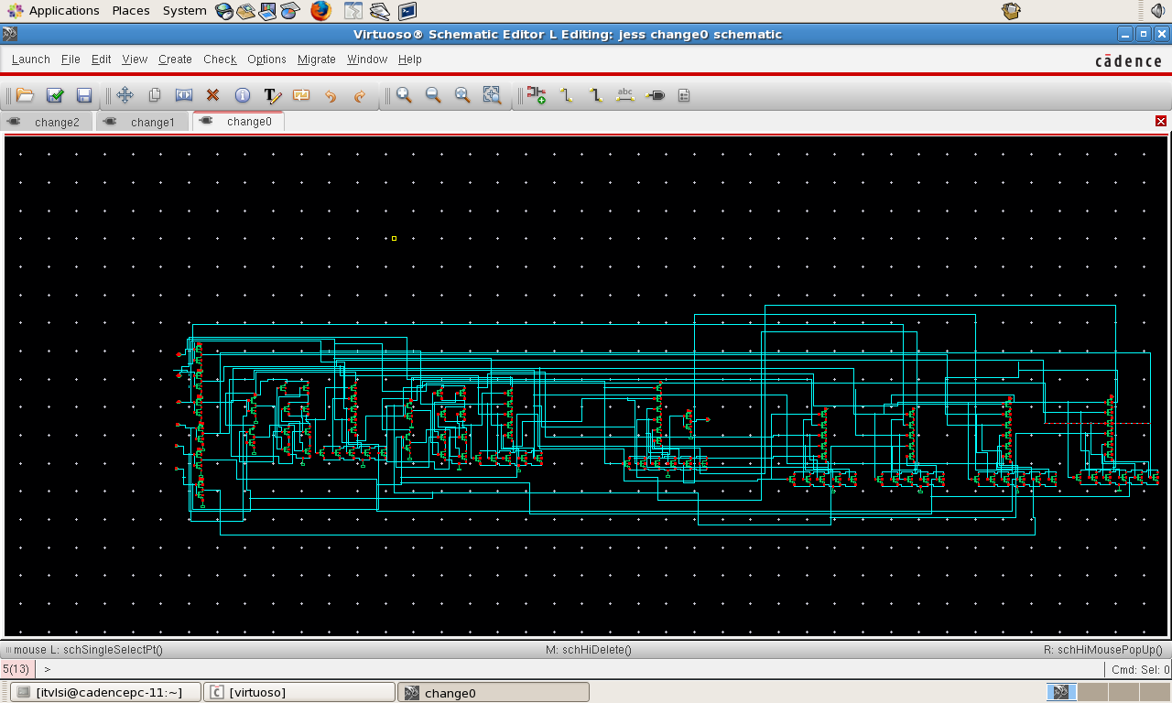
Schematics(c0)

Slide 15
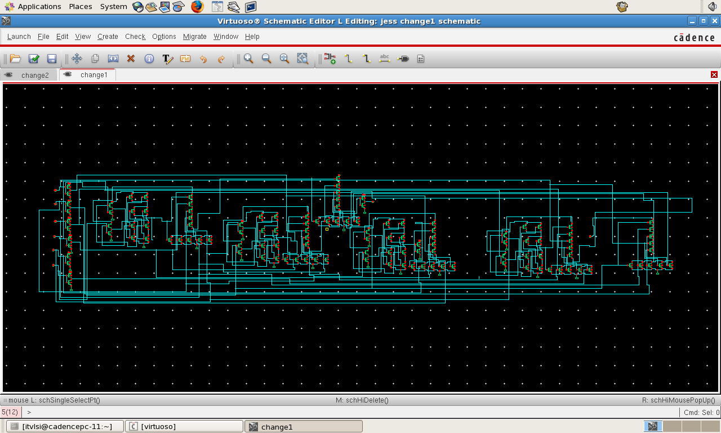
Schematics(c1)

Slide 16
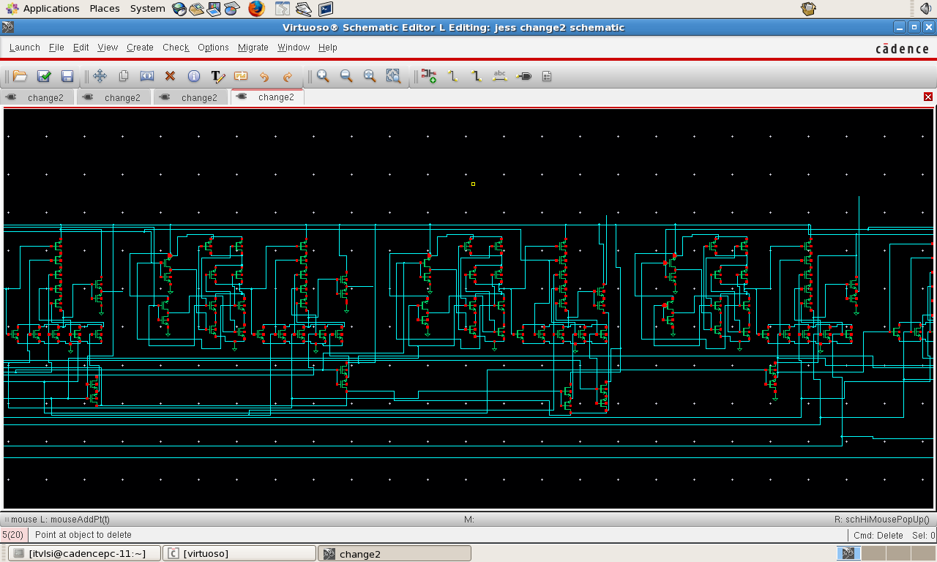
Schematics(c2)

Slide 17
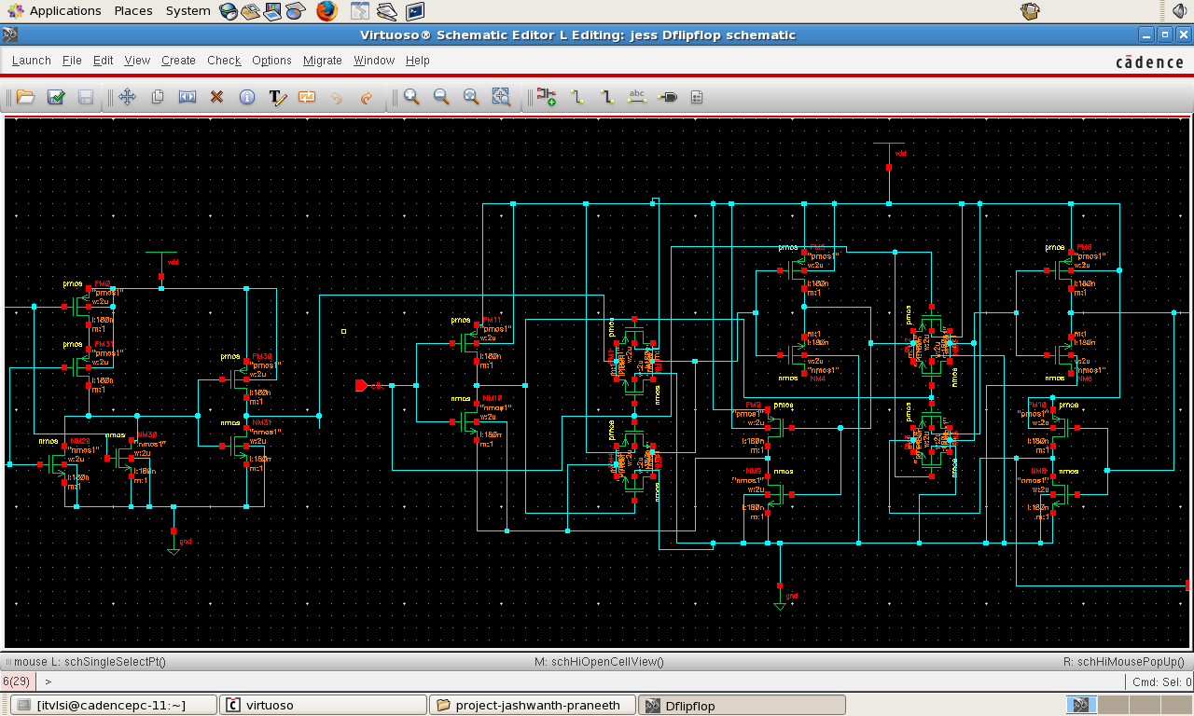
Schematics(D flip flop)

Slide 18
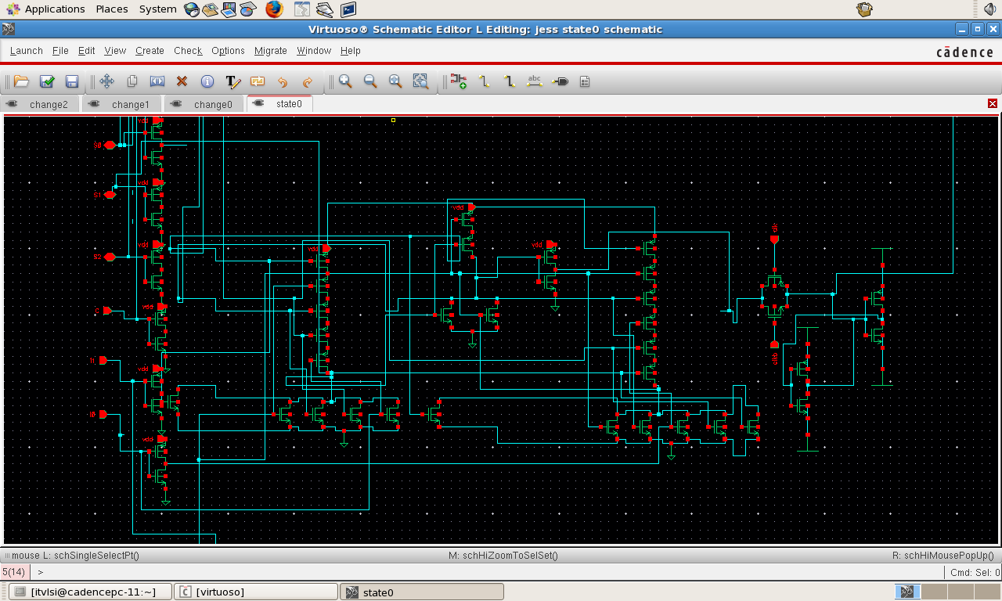
Schematics(next state 0)

Slide 19
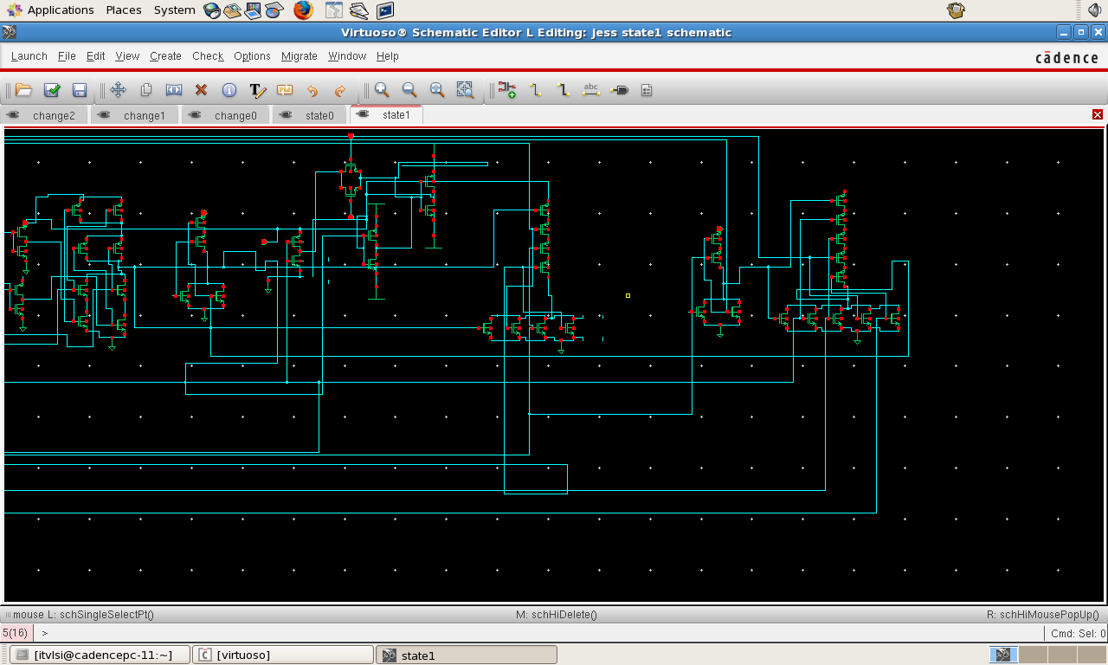
Schematic(next state 1)

Slide 20
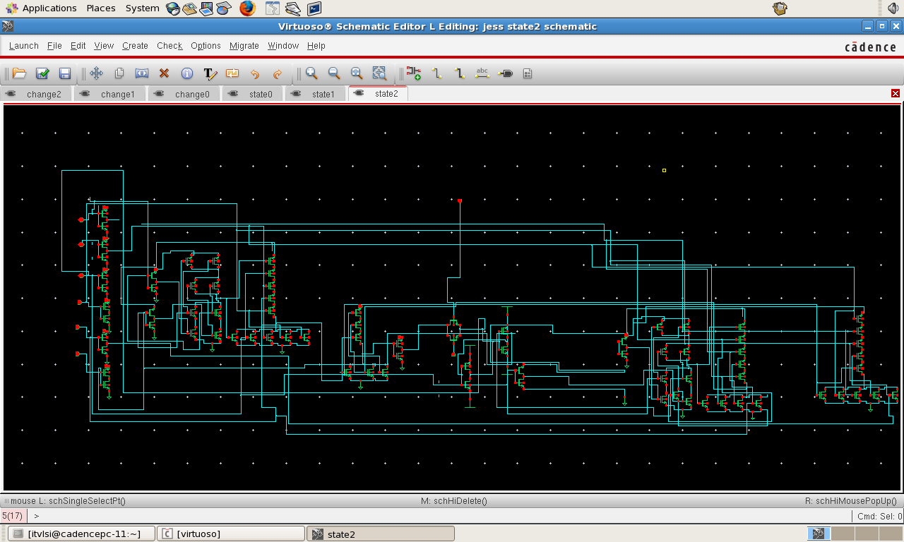
Schematic(next state 2)

Slide 21
Problem Of Dynamic Power
Dynamic power equation is
Pd = αC_{L}V²f
All parameters are fixed for a fixed design
Can decrease α if we choose the probability of one of the output to be high

Slide 22
Transistors and power
Total number of transistors were around 250.
Each transistor on a chip dissipates a small amount of power when it is switched, and transistors that are switched rapidly dissipate more power than transistors that are switched slowly. The total amount of power dissipated per unit area due to switching of a chip's transistors is called dynamic power density. There are two factors that work together to cause an increase in dynamic power density: clockspeed and transistor density.

Slide 23
Static power dissipation
Static dissipation due to reverse leakage currents that occur in the sub threshold region and
power(static)=Vdd*I(leakage).
So this can be reduced by applying low power supply in the design.

